Slide 1
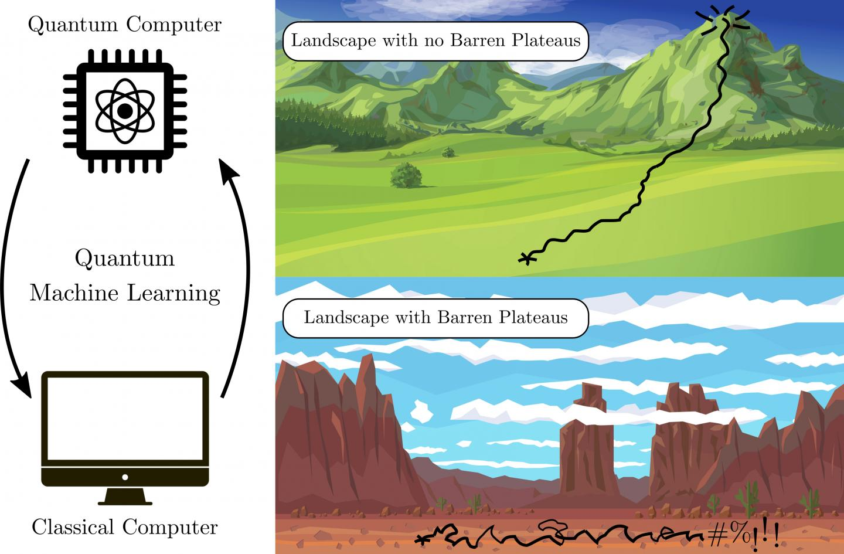
Barren plateaus

Slide 2
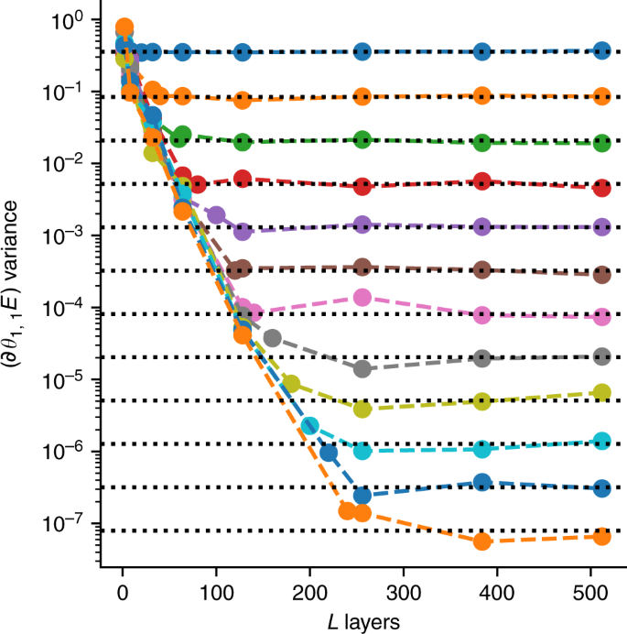

Slide 3
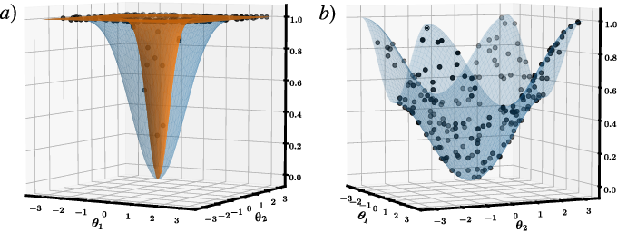

Slide 4
Quantum natural gradient
James Stokes, Josh Izaac, Nathan Killoran, Giuseppe Carleo
2019

Slide 5

Suppose we have a model parameterized by parameter vector $θ$ that models a distribution $p\left(X | θ\right)$. Our goal is to maximize the log-likelihood $\log{p(X|θ)}$, we defind the score function:
$$s\left(θ\right)=∇log⁡p(X|θ)$$

Slide 6
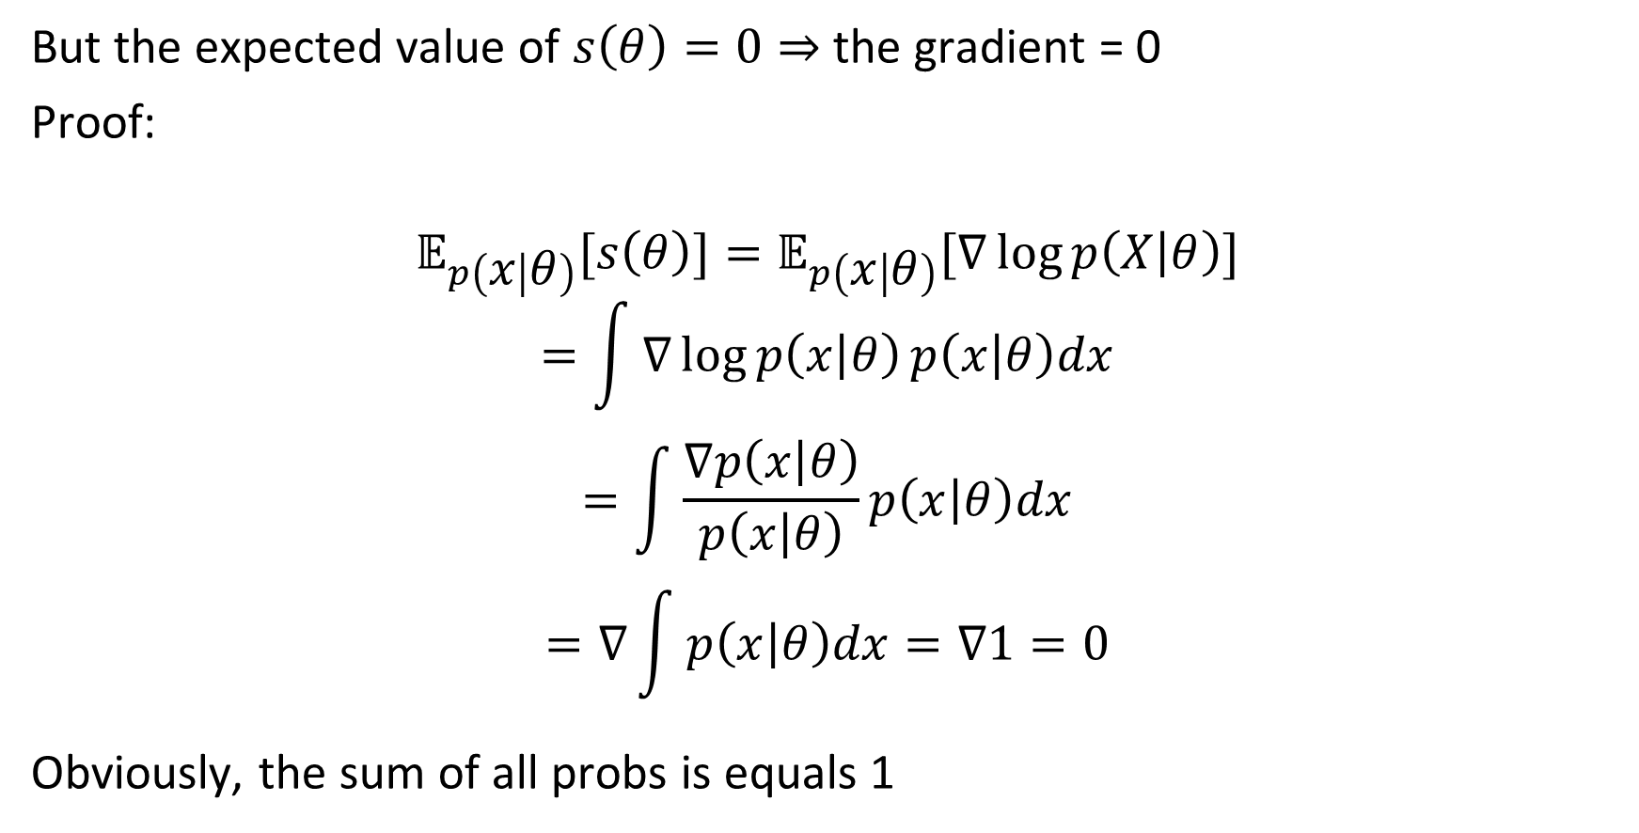
But the expected value of $s\left(θ\right)=0⇒$ the gradient = 0
Proof:
$$𝔼_{p\left(x | θ\right)}[s\left(θ\right)]=𝔼_{p\left(x | θ\right)}[∇\log{p\left(X | θ\right)}]$$
$$=\int{∇\log{p\left(x | θ\right)}p\left(x | θ\right)dx}$$
$$=\int{\frac{∇p\left(x | θ\right)}{p\left(x | θ\right)}p\left(x | θ\right)dx}$$
$$=∇\int{p\left(x | θ\right)dx=∇1=0}$$
Obviously, the sum of all probs is equals 1

Slide 7

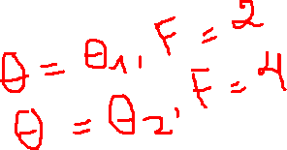
1. Fisher information
Measuring the amount of information that an observable random variable $X$ carries about an unknown parameter $θ$ of a distribution that models $X$.

Slide 8

1. Fisher information
Expected value of the
Square of the
Derivative of the
Log of the
Likelihood of the
Random sample $x_{1},x_{2},…, x_{n}$

Slide 9
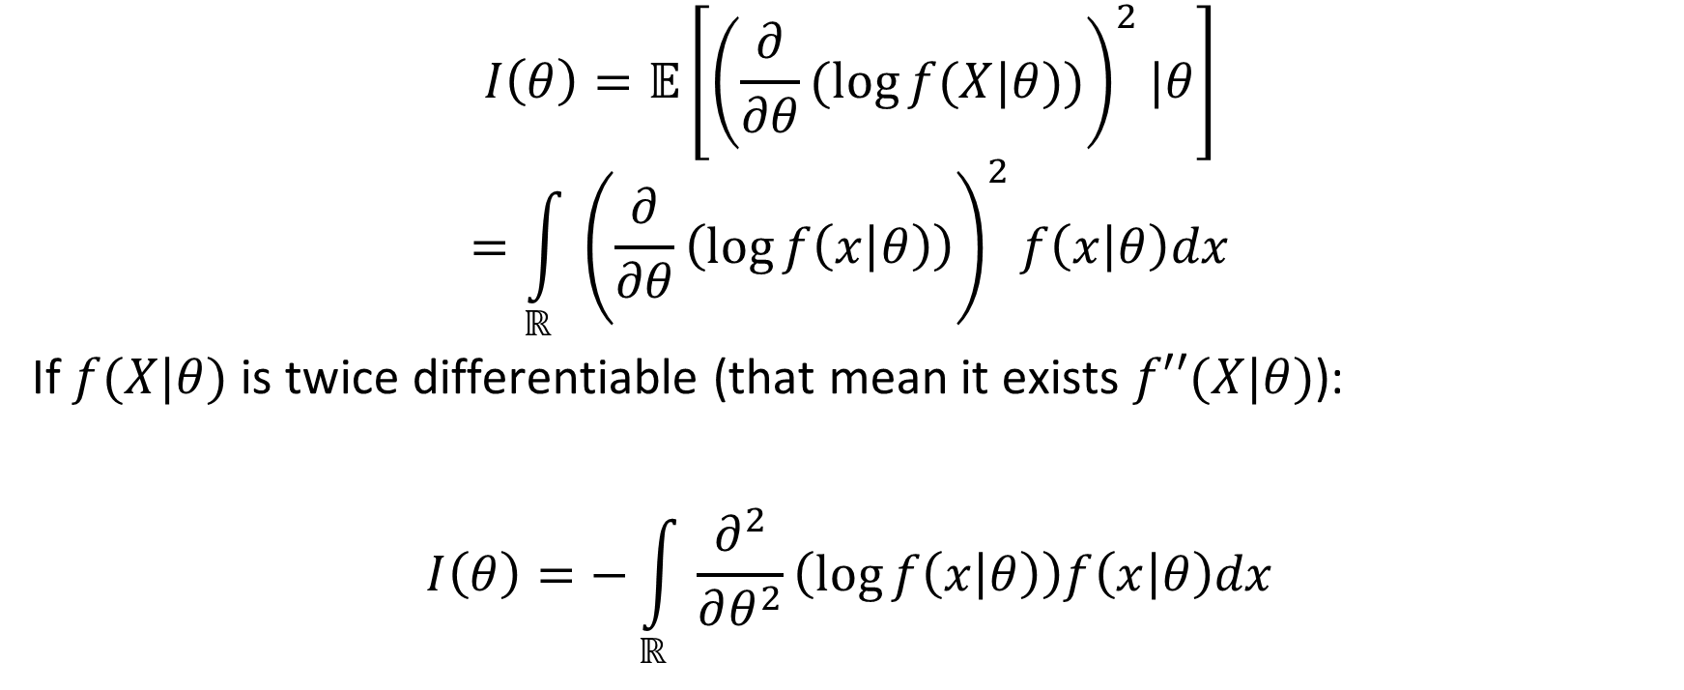
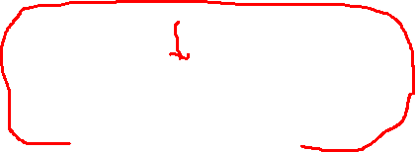
1. Fisher information
$$I\left(θ\right)=𝔼\left[{\left(\frac{∂}{∂θ}(\log{f(X|θ)})\right)}^{2}|θ\right]$$
$$=\int_{ℝ}{{\left(\frac{∂}{∂θ}\left(\log{f\left(x | θ\right)}\right)\right)}^{2}f\left(x | θ\right)dx}$$
If $f(X|θ)$ is twice differentiable (that mean it exists $f′′(X|θ)$):
$$I\left(θ\right)=−\int_{ℝ}{\frac{∂^{2}}{∂θ^{2}}\left(\log{f\left(x | θ\right)}\right)f\left(x | θ\right)dx}$$

Slide 10
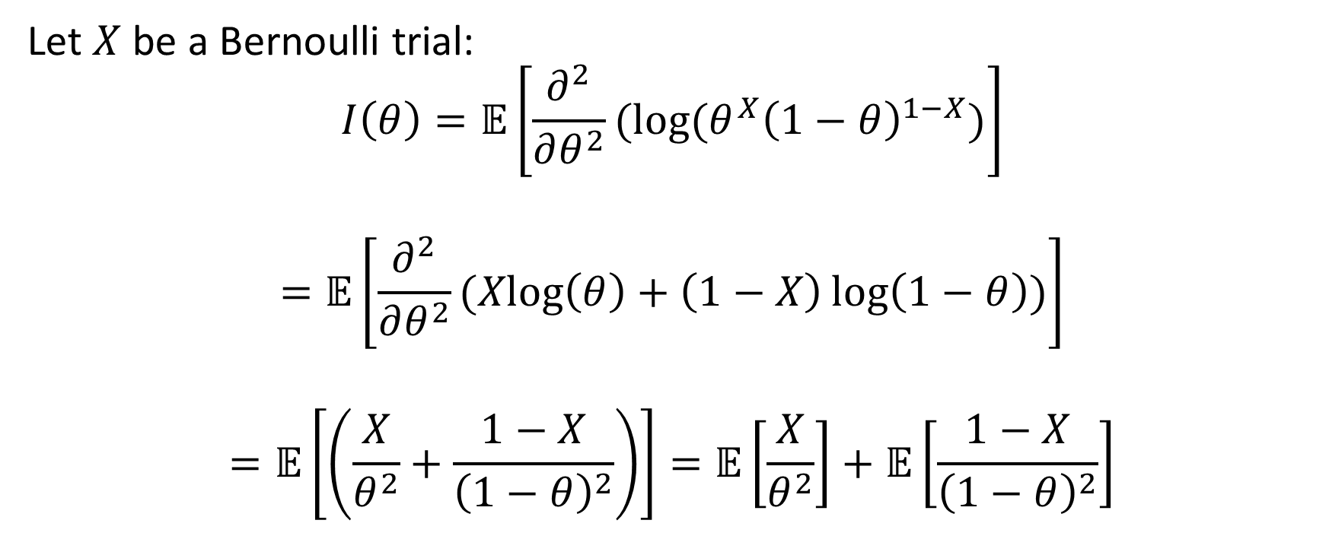
1. Fisher information: simple case
Let $X$ be a Bernoulli trial:
$$I\left(θ\right)=𝔼\left[\frac{∂^{2}}{∂θ^{2}}(\log{(θ^{X}{\left(1−θ\right)}^{1−X})}\right]$$
$$=𝔼\left[\frac{∂^{2}}{∂θ^{2}}(\operatorname{Xlog}\left(θ\right)+\left(1−X\right)\log\left(1−θ\right))\right]$$
$$=𝔼\left[\left(\frac{X}{θ^{2}}+\frac{1−X}{{\left(1−θ\right)}^{2}}\right)\right]=𝔼\left[\frac{X}{θ^{2}}\right]+𝔼\left[\frac{1−X}{{\left(1−θ\right)}^{2}}\right]$$

Slide 11

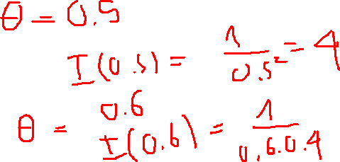
1. Fisher information: simple case
We have:
$$𝔼\left(X\right)=𝔼=θ$$
$$=𝔼\left[\frac{X}{θ^{2}}\right]+𝔼\left[\frac{1−X}{{\left(1−θ\right)}^{2}}\right]=\frac{1}{θ}+\frac{1−θ}{{\left(1−θ\right)}^{2}}=\frac{1−θ+θ}{θ(1−θ)}=\frac{1}{θ(1−θ)}$$

Slide 12

1. Fisher information: matrix form
In case of $θ={\left[\begin{matrix}θ_{1} & θ_{2} & \begin{matrix}… & θ_{N}\end{matrix}\end{matrix}\right]}^{T}$, $I(θ)$ is a $N×N$ matrix:
$$[I{\left(θ\right)]}_{ij}=𝔼\left[\left(\frac{∂}{θ_{i}}\log{f(X|θ)}\right)\left(\frac{∂}{θ_{j}}\log{f(X|θ)}\right)\right]$$

Slide 13
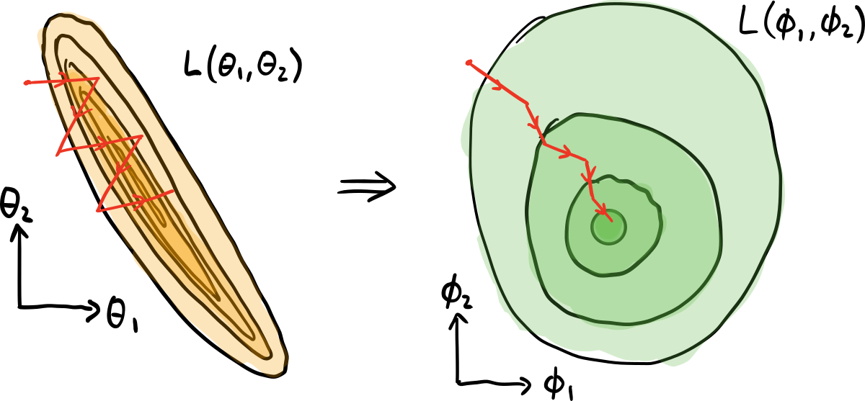

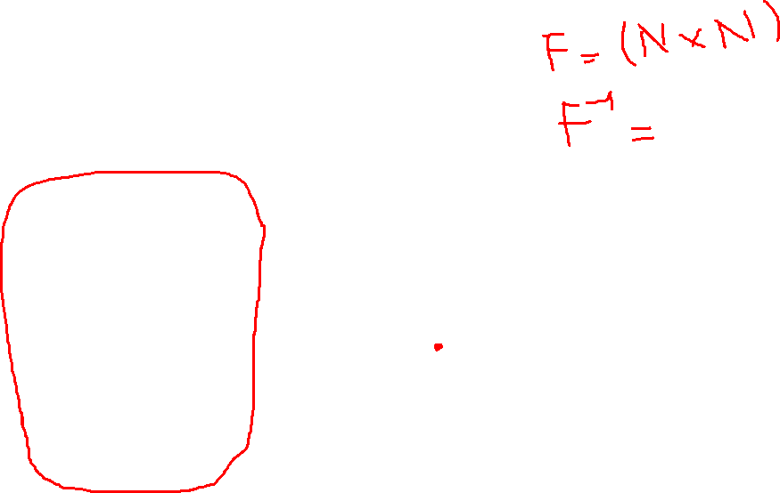
2. Natural gradient descent (NGD)
$$θ^{t+1}=θ^{t}−αF^{−1}\left(θ^{t}\right)∇_{θ}ℒ(θ^{t})$$
With $F$ is the Fisher information matrix.
Notes:
The Fisher information matrix acts as a metric tensor, transforming the steepest descent in the Euclidean parameter space to the steepest descent in the distribution space

Slide 14
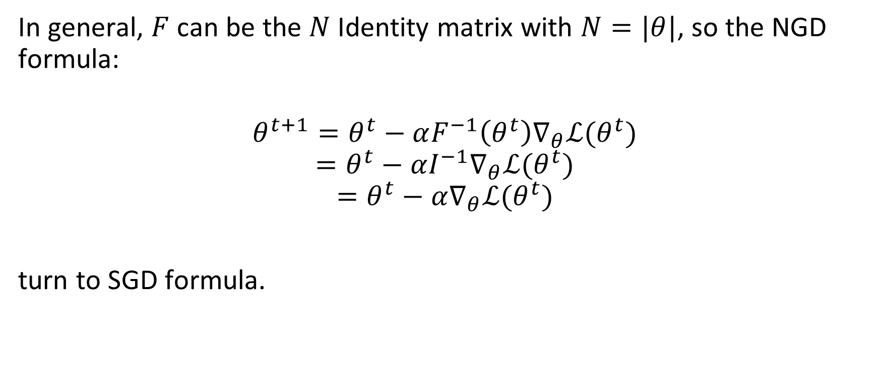
2. Natural gradient descent (NGD)
In general, $F$ can be the $N$ Identity matrix with $N=|θ|$, so the NGD formula:
$$θ^{t+1}=θ^{t}−αF^{−1}\left(θ^{t}\right)∇_{θ}ℒ(θ^{t})$$
$$=θ^{t}−αI^{−1}∇_{θ}ℒ(θ^{t})$$
$$=θ^{t}−α∇_{θ}ℒ(θ^{t})$$
turn to SGD formula.
Notes:
The Fisher information matrix acts as a metric tensor, transforming the steepest descent in the Euclidean parameter space to the steepest descent in the distribution space

Slide 15
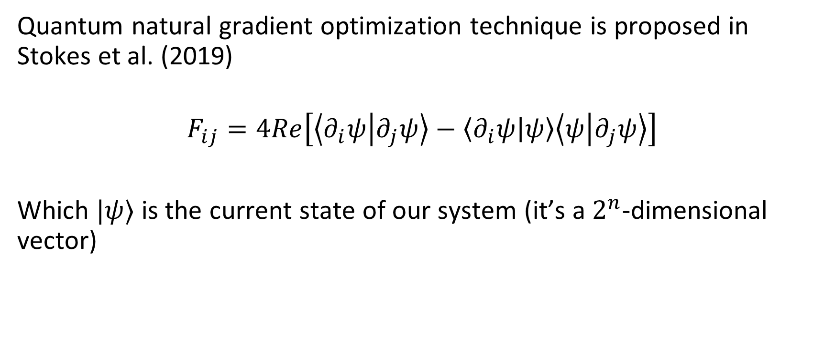
3. Quantum NGD
Quantum natural gradient optimization technique is proposed in Stokes et al. (2019)
$$F_{ij}=4Re\left[\left\langle ∂_{i}ψ | ∂_{j}ψ\right\rangle −\left\langle ∂_{i}ψ | ψ\right\rangle \left\langle ψ | ∂_{j}ψ\right\rangle \right]$$
Which $|ψ⟩$ is the current state of our system (it’s a $2^{n}$-dimensional vector)

Slide 16
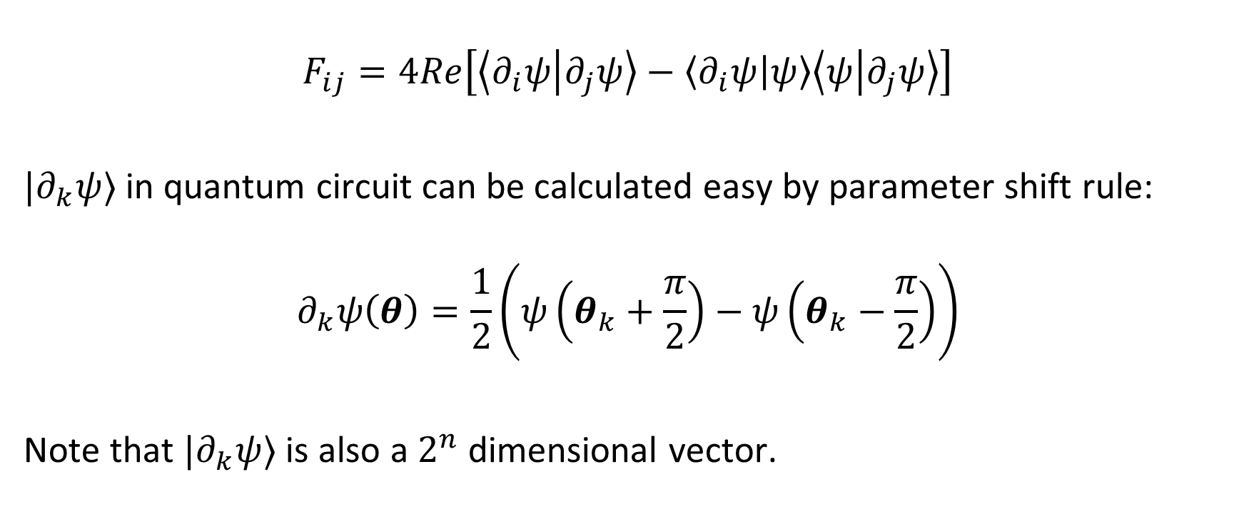
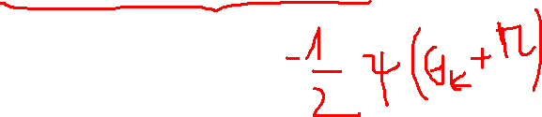
3. Quantum NGD
$$F_{ij}=4Re\left[\left\langle ∂_{i}ψ | ∂_{j}ψ\right\rangle −\left\langle ∂_{i}ψ | ψ\right\rangle \left\langle ψ | ∂_{j}ψ\right\rangle \right]$$
$|∂_{k}ψ⟩$ in quantum circuit can be calculated easy by parameter shift rule:
$$∂_{k}ψ\left(θ\right)=\frac{1}{2}\left(ψ\left(θ_{k}+\frac{π}{2}\right)−ψ\left(θ_{k}−\frac{π}{2}\right)\right)$$
Note that $|∂_{k}ψ⟩$ is also a $2^{n}$ dimensional vector.

Slide 17

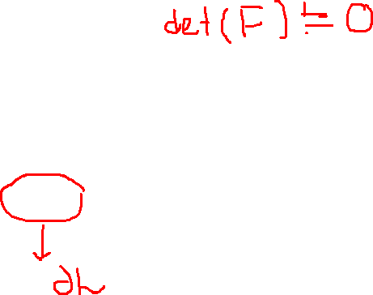
3. Quantum NGD
Fact that $F$ is real and Hermitian, so $F_{ij}=F_{ji}$ for all $i,j$
$$θ^{t+1}=θ^{t}−αF^{−1}\left(θ^{t}\right)∇_{θ}ℒ(θ^{t})$$
$$=θ^{t}−αK(θ^{t})$$

Slide 18
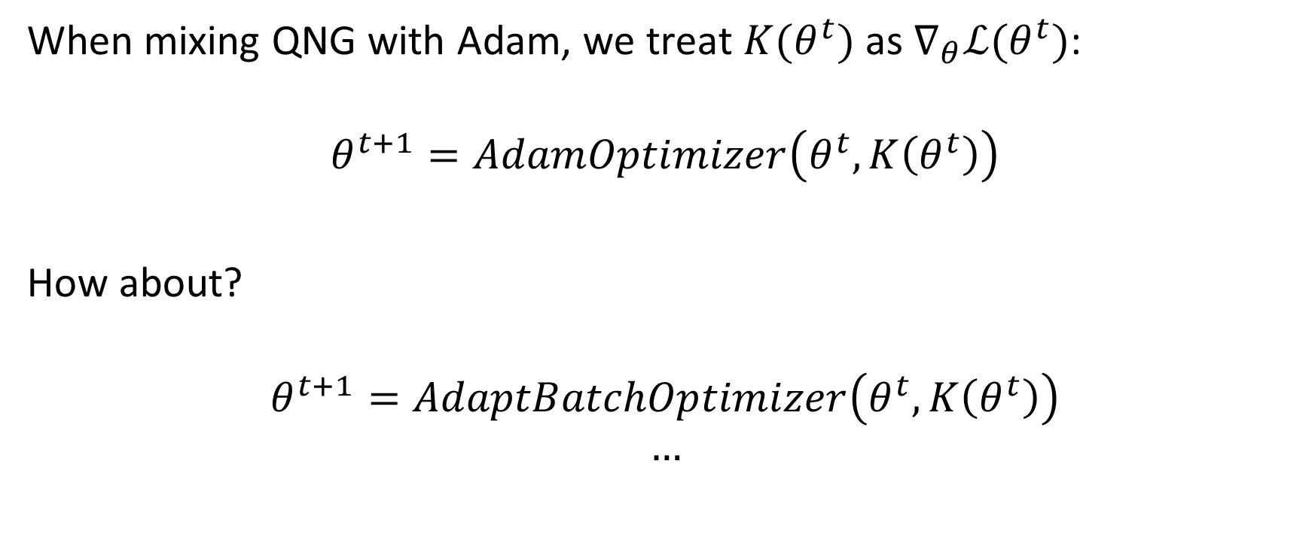

3. QNG – Adam or QNG – AdaptBatch, QNG – AdaptLR, …
When mixing QNG with Adam, we treat $K(θ^{t})$ as $∇_{θ}ℒ(θ^{t})$:
$$θ^{t+1}=AdamOptimizer\left(θ^{t},K\left(θ^{t}\right)\right)$$
How about?
$$θ^{t+1}=AdaptBatchOptimizer\left(θ^{t},K\left(θ^{t}\right)\right)$$
$$…$$

Slide 19
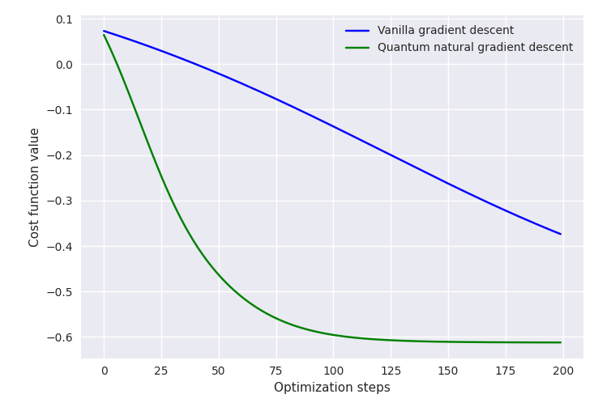

4. Experiments
From penny-lane benchmark

Slide 20
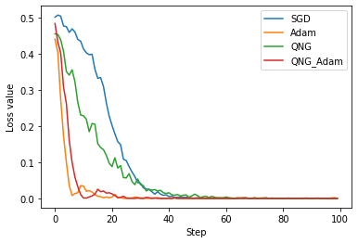
4. Experiments
When optimizing 1-qubit circuit (simplest case)

Slide 21
Fubini-study tensor metric
James Stokes, Josh Izaac, Nathan Killoran, Giuseppe Carleo
2019

Slide 22
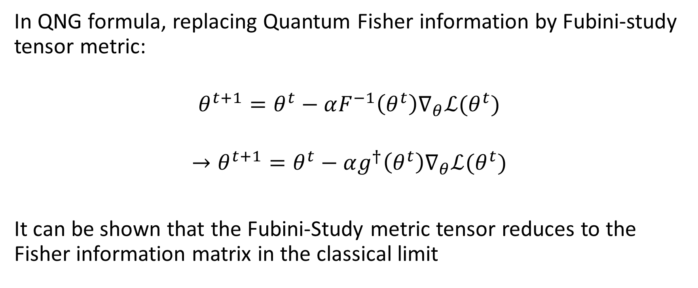
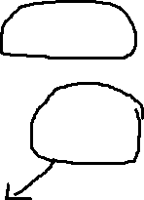
1. Intro
In QNG formula, replacing Quantum Fisher information by Fubini-study tensor metric:
$$θ^{t+1}=θ^{t}−αF^{−1}\left(θ^{t}\right)∇_{θ}ℒ(θ^{t})$$
$$→θ^{t+1}=θ^{t}−αg^{†}\left(θ^{t}\right)∇_{θ}ℒ(θ^{t})$$
It can be shown that the Fubini-Study metric tensor reduces to the Fisher information matrix in the classical limit

Slide 23
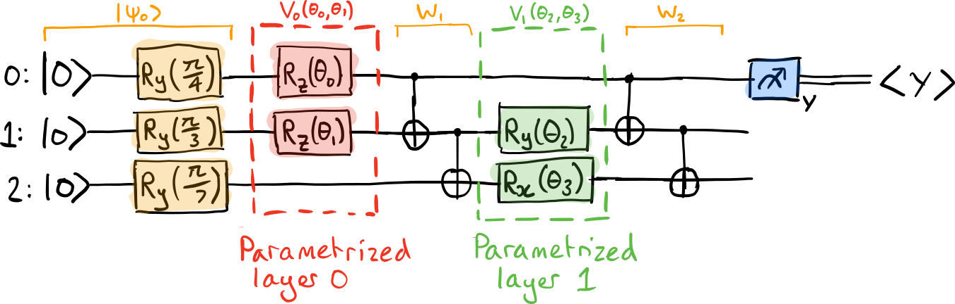
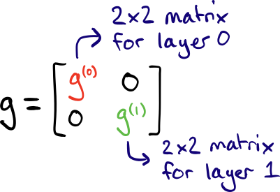
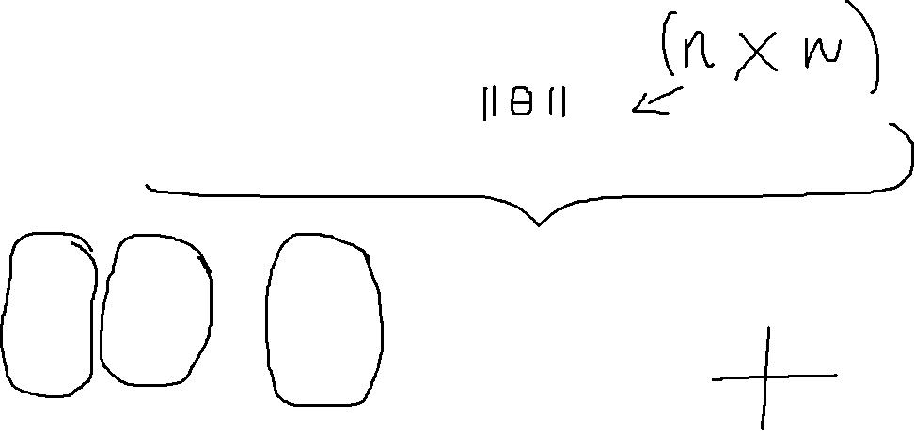
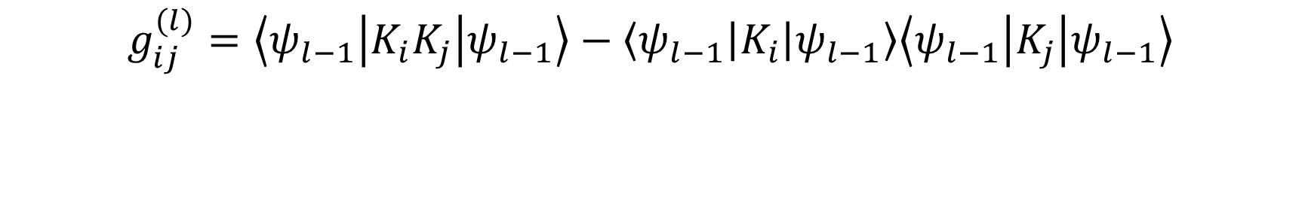


2. Block-diagonal metric tensor
$$g_{ij}^{(l)}=\left\langle ψ_{l−1}\left|K_{i}K_{j}\right|ψ_{l−1}\right\rangle −\left\langle ψ_{l−1}\left|K_{i}\right|ψ_{l−1}\right\rangle \left\langle ψ_{l−1}\left|K_{j}\right|ψ_{l−1}\right\rangle$$
$$|ψ_{1}⟩$$
$$|ψ_{2}⟩$$

Slide 24
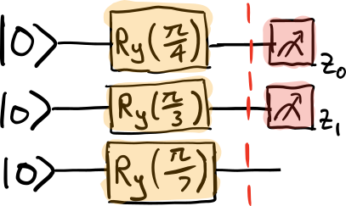
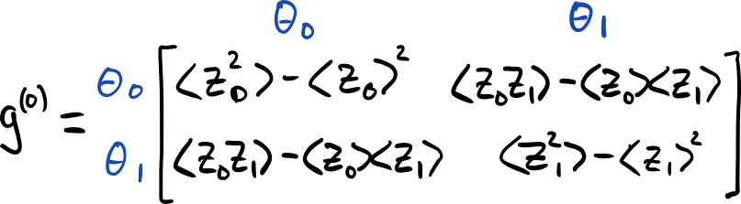
2. Block-diagonal metric tensor

Slide 25
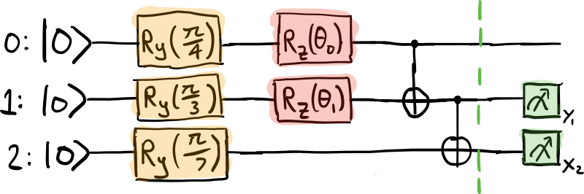
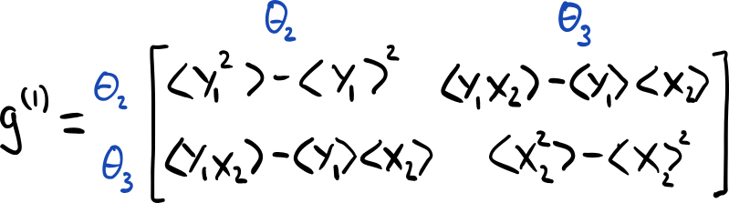
2. Block-diagonal metric tensor

Slide 26
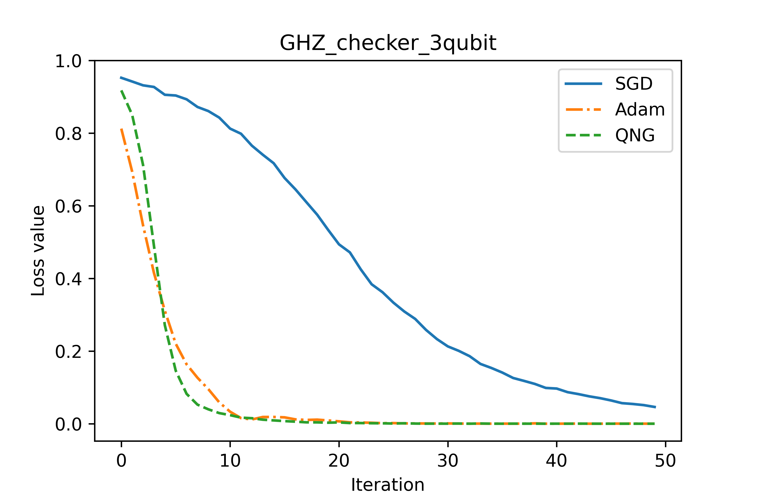
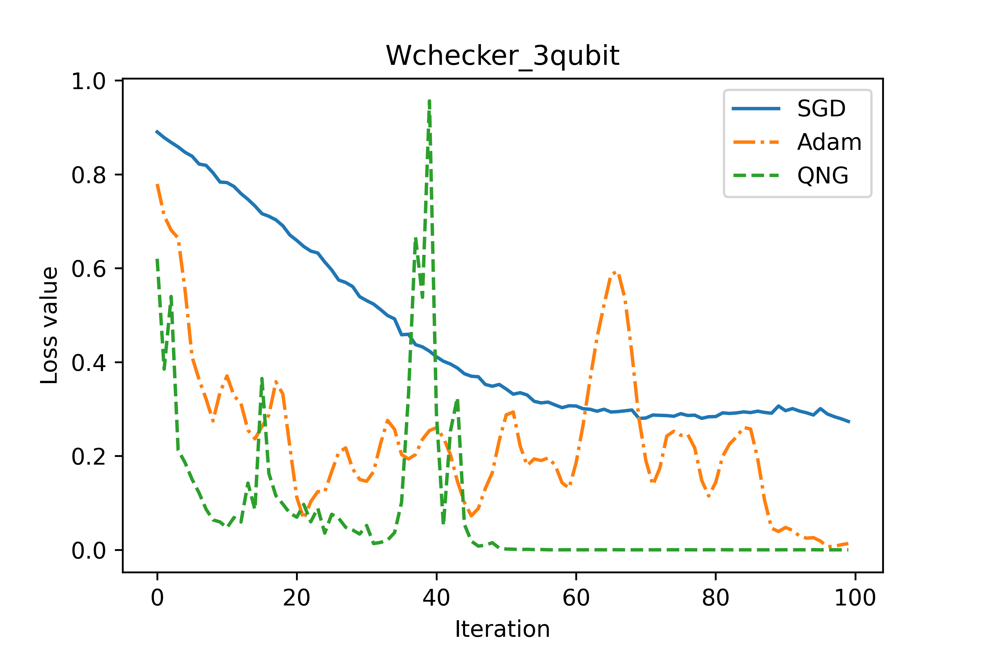

3. Experiments
Through experiments, I see that $\det\left(g\right)≈0 (<{10}^{−10})$ but its inverse $g^{†}$ is good (not explode as Quantum Fisher matrix).

